Slide 1




Linear Data Structures
Arrays, Lists, Stacks, Queues Static and Dynamic Implementation
Svetlin Nakov
Technical Trainer
www.nakov.com
Telerik Software Academy
academy.telerik.com

Slide 2

Table of Contents
Lists
Static and Linked Implementation
List<T> and LinkedList<T>
Stacks
Static and Linked Implementation
The Stack<T> Class
Queues
Circular and Linked Implementation
The Queue<T> Class

Slide 3

Lists
Static and Dynamic Implementations

Slide 4
The List ADT
What is "list"?
A data structure (container) that contains a sequence of elements
Can have variable size
Elements are arranged linearly, in sequence
Can be implemented in several ways
Statically (using array → fixed size)
Dynamically (linked implementation)
Using resizable array (the List<T> class)

Slide 5

Static List
Implemented by an array
Provides direct access by index
Has fixed capacity
Insertion, deletion and resizing are slow operations
0 1 2 3 4 5 6 7
L
2 | 18 | 7 | 12 | 3 | 6 | 11 | 9

Slide 6

Linked List
Dynamic (pointer-based) implementation
Different forms
Singly-linked and doubly-linked
Sorted and unsorted
Singly-linked list
Each item has 2 fields: value and next
2
next
7
next
4
next
5
next
null
head

Slide 7
Linked List (2)
Doubly-linked List
Each item has 3 fields: value, next and prev
head
tail
2
next
prev
7
next
prev
4
next
prev
5
next
prev
null
null

Slide 8

The List<T> Class
Auto-Resizable Indexed Lists

Slide 9
The List<T> Class
Implements the abstract data structure list using an array
All elements are of the same type T
T can be any type, e.g. List<int>, List<string>, List<DateTime>
Size is dynamically increased as needed
Basic functionality:
Count – returns the number of elements
Add(T) – appends given element at the end

Slide 10
List<T> – Simple Example
static void Main()
{
List<string> list = new List<string>() { "C#", "Java" };
list.Add("SQL");
list.Add("Python");
foreach (string item in list)
{
Console.WriteLine(item);
}
// Result:
// C#
// Java
// SQL
// Python
}
Inline initialization: the compiler adds specified elements to the list.

Slide 11

List<T> – Simple Example
Live Demo

Slide 12
List<T> – Functionality
list[index] – access element by index
Insert(index, T) – inserts given element to the list at a specified position
Remove(T) – removes the first occurrence of given element
RemoveAt(index) – removes the element at the specified position
Clear() – removes all elements
Contains(T) – determines whether an element is part of the list

Slide 13
List<T> – Functionality (2)
IndexOf() – returns the index of the first occurrence of a value in the list (zero-based)
Reverse() – reverses the order of the elements in the list or a portion of it
Sort() – sorts the elements in the list or a portion of it
ToArray() – converts the elements of the list to an array
TrimExcess() – sets the capacity to the actual number of elements

Slide 14
List<T>: How It Works?
Capacity
List<int>:
Count = 9
Capacity = 15
3 | 4 | 1 | 0 | 0 | 7 | 1 | 1 | 4
used buffer
(Count)
unused buffer
List<T> keeps a buffer memory, allocated in advance, to allow fast Add(T)
Most operations use the buffer memory and do not allocate new objects
Occasionally the capacity grows (doubles)

Slide 15
Primes in an Interval – Example
static List<int> FindPrimes(int start, int end)
{
List<int> primesList = new List<int>();
for (int num = start; num <= end; num++)
{
bool prime = true;
for (int div = 2; div <= Math.Sqrt(num); div++)
{
if (num % div == 0)
{
prime = false;
break;
}
}
if (prime)
{
primesList.Add(num);
}
}
return primesList;
}

Slide 16
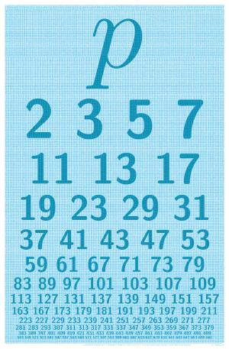
Primes in an Interval
Live Demo

Slide 17
Union and Intersection – Example
int[] Union(int[] firstArr, int[] secondArr) {
List<int> union = new List<int>();
union.AddRange(firstArray);
foreach (int item in secondArray)
if (! union.Contains(item))
union.Add(item);
return union.ToArray();
}
int[] Intersection(int[] firstArr, int[] secondArr)
{
List<int> intersect = new List<int>();
foreach (int item in firstArray)
if (Array.IndexOf(secondArray, item) != -1)
intersect.Add(item);
return intersect.ToArray();
}

Slide 18

Union and Intersection
Live Demo

Slide 19
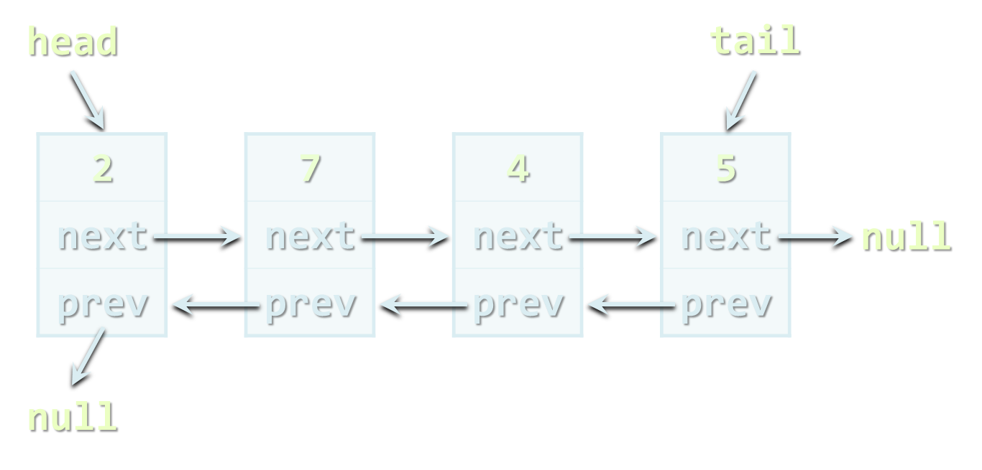
The LinkedList<T> Class
Dynamic Linked List in .NET

Slide 20
The LinkedList<T> Class
Implements the abstract data structure list using a doubly-linked dynamic structure
All elements are of the same type T
T can be any type, e.g. LinkedList<int>, LinkedList<string>, etc.
Elements can be added at both sides
Basic LinkedList<T> functionality:
AddFirst(T), AddLast(T), AddBefore(T), AddAfter(T), RemoveFirst(T), RemoveLast(T), Count

Slide 21
LinkedList<T> – Example
static void Main()
{
LinkedList<string> list =
new LinkedList<string>();
list.AddFirst("First");
list.AddLast("Last");
list.AddAfter(list.First, "After First");
list.AddBefore(list.Last, "Before Last");
Console.WriteLine(String.Join(", ", list));
// Result: First, After First, Before Last, Last
}

Slide 22
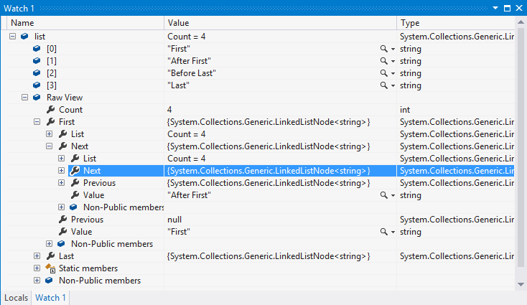
LinkedList<T>
Live Demo

Slide 23

Sorting Lists
Several Ways to Do It

Slide 24
Sorting Lists
List<DateTime> list = new List<DateTime>()
{
new DateTime(2013, 4, 7),
new DateTime(2002, 3, 12),
new DateTime(2012, 1, 4),
new DateTime(1980, 11, 11)
};
list.Sort();
list.Sort((d1, d2) => -d1.Year.CompareTo(d2.Year));
list.OrderBy(date => date.Month)));

Slide 25
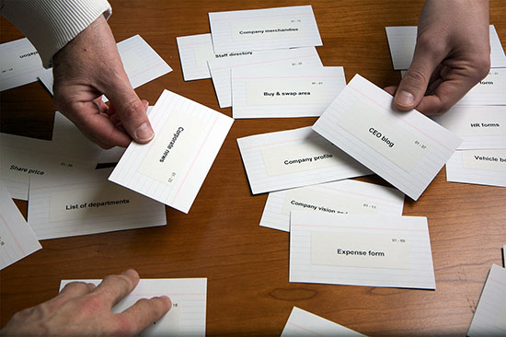
Sorting Lists
Live Demo

Slide 26

Stacks
Static and Dynamic Implementation

Slide 27
The Stack ADT
LIFO (Last In First Out) structure
Elements inserted (push) at “top”
Elements removed (pop) from “top”
Useful in many situations
E.g. the execution stack of the program
Can be implemented in several ways
Statically (using array)
Dynamically (linked implementation)
Using the Stack<T> class

Slide 28
Static Stack
Static (array-based) implementation
Has limited (fixed) capacity
The current index (top) moves left / right with each pop / push
0 1 2 3 4 5 6 7
S
2 | 18 | 7 | 12
top

Slide 29
Linked Stack
Dynamic (pointer-based) implementation
Each item has 2 fields: value and next
Special pointer keeps the top element
top
2
next
7
next
4
next
5
next
null

Slide 30

The Stack<T> Class
The Standard Stack Implementation in .NET

Slide 31
The Stack<T> Class
Implements the stack data structure using an array
Elements are from the same type T
T can be any type, e.g. Stack<int>
Size is dynamically increased as needed
Basic functionality:
Push(T) – inserts elements to the stack
Pop() – removes and returns the top element from the stack

Slide 32
The Stack<T> Class (2)
Basic functionality:
Peek() – returns the top element of the stack without removing it
Count – returns the number of elements
Clear() – removes all elements
Contains(T) – determines whether given element is in the stack
ToArray() – converts the stack to an array
TrimExcess() – sets the capacity to the actual number of elements

Slide 33
Stack<T> – Example
Using Push(), Pop() and Peek() methods
static void Main()
{
Stack<string> stack = new Stack<string>();
stack.Push("1. Ivan");
stack.Push("2. Nikolay");
stack.Push("3. Maria");
stack.Push("4. George");
Console.WriteLine("Top = {0}", stack.Peek());
while (stack.Count > 0)
{
string personName = stack.Pop();
Console.WriteLine(personName);
}
}

Slide 34

Stack<T>
Live Demo

Slide 35
Matching Brackets – Example
We are given an arithmetical expression with brackets that can be nested
Goal: extract all sub-expressions in brackets
Example:
1 + (2 - (2+3) * 4 / (3+1)) * 5
Result:
(2+3) | (3+1) | (2 - (2+3) * 4 / (3+1))
Algorithm:
For each '(' push its index in a stack
For each ')' pop the corresponding start index

Slide 36
Matching Brackets – Solution
string expression = "1 + (2 - (2+3) * 4 / (3+1)) * 5";
Stack<int> stack = new Stack<int>();
for (int index = 0; index < expression.Length; index++)
{
char ch = expression[index];
if (ch == '(')
{
stack.Push(index);
}
else if (ch == ')')
{
int startIndex = stack.Pop();
int length = index - startIndex + 1;
string contents = expression.Substring(startIndex, length);
Console.WriteLine(contents);
}
}

Slide 37

Matching Brackets
Live Demo

Slide 38

Queues
Static and Dynamic Implementation

Slide 39
The Queue ADT
FIFO (First In First Out) structure
Elements inserted at the tail (Enqueue)
Elements removed from the head (Dequeue)
Useful in many situations
Print queues, message queues, etc.
Can be implemented in several ways
Statically (using array)
Dynamically (using pointers)
Using the Queue<T> class

Slide 40
Static Queue
Static (array-based) implementation
Has limited (fixed) capacity
Implement as a “circular array”
Has head and tail indices, pointing to the head and the tail of the cyclic queue
0 1 2 3 4 5 6 7
S
 |  | 7 | 12 | 2 | 5
head
tail

Slide 41
Linked Queue
Dynamic (pointer-based) implementation
Each item has 2 fields: value and next
Dynamically create and delete objects
head
tail
2
next
7
next
4
next
5
next
null

Slide 42

The Queue<T> Class
Standard Queue Implementation in .NET

Slide 43
The Queue<T> Class
Implements the queue data structure using a circular resizable array
Elements are from the same type T
T can be any type, e.g. Stack<int>
Size is dynamically increased as needed
Basic functionality:
Enqueue(T) – adds an element to the end of the queue
Dequeue() – removes and returns the element at the beginning of the queue

Slide 44
The Queue<T> Class (2)
Basic functionality:
Peek() – returns the element at the beginning of the queue without removing it
Count – returns the number of elements
Clear() – removes all elements
Contains(T) – determines whether given element is in the queue
ToArray() – converts the queue to an array
TrimExcess() – sets the capacity to the actual number of elements in the queue

Slide 45
Queue<T> – Example
Using Enqueue() and Dequeue() methods
static void Main()
{
Queue<string> queue = new Queue<string>();
queue.Enqueue("Message One");
queue.Enqueue("Message Two");
queue.Enqueue("Message Three");
queue.Enqueue("Message Four");
while (queue.Count > 0)
{
string message = queue.Dequeue();
Console.WriteLine(message);
}
}

Slide 46

The Queue<T> Class
Live Demo

Slide 47
Sequence N, N+1, 2*N
We are given the sequence:
S = N, N+1, 2*N, N+2, 2*(N+1), 2*N+1, 4*N, …
Find the first index of given number P
Example: N = 3, P = 16
S = 3, 4, 6, 5, 8, 7, 12, 6, 10, 9, 16, 8, 14, …
Index of P = 11
+1
+1
+1
*2
*2
*2

Slide 48
Sequence – Solution with a Queue
int n = 3, p = 16;
Queue<int> queue = new Queue<int>();
queue.Enqueue(n);
int index = 0;
while (queue.Count > 0)
{
int current = queue.Dequeue();
index++;
if (current == p)
{
Console.WriteLine("Index = {0}", index);
return;
}
queue.Enqueue(current+1);
queue.Enqueue(2*current);
}

Slide 49

Sequence N, N+1, 2*N
Live Demo

Slide 50
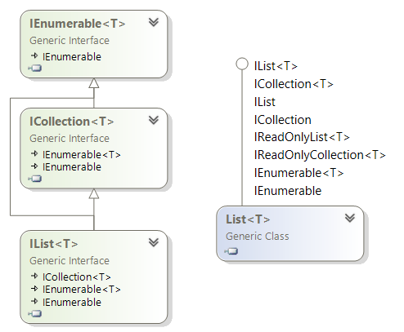
List Interfaces in .NET
IEnumerable, ICollection, IList, …

Slide 51
List Interfaces in .NET
IEnumerable, IEnumerable<T>
GetEnumerator() → Current, MoveNext()
ICollection, ICollection<T>
Inherits from IEnumerable<T>
Count, Add(…), Remove(…), Contains(…)
IList, IList<T>
Inherits from ICollection<T>
Item / indexer [], Insert(…), RemoveAt(…)

Slide 52
List Interfaces Hierarchy

Slide 53
Summary
The basic linear data structures in the computer programming are:
List (static, linked)
Implemented by the List<T> and LinkedList<T> classes in .NET
Stack (static, linked)
Implemented by the Stack<T> class in .NET
Queue (static, linked)
Implemented by the Queue<T> class in .NET

Slide 54
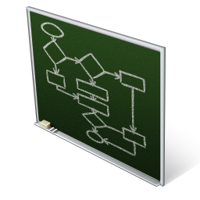

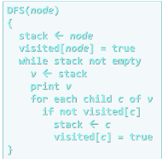
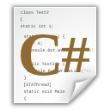
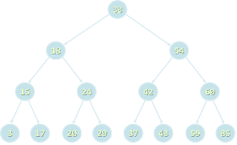
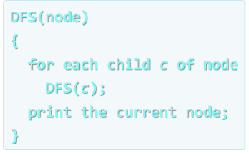
Linear Data Structures
http://academy.telerik.com

Slide 55
Exercises
Write a program that reads from the console a sequence of positive integer numbers. The sequence ends when empty line is entered. Calculate and print the sum and average of the elements of the sequence. Keep the sequence in List<int>.
Write a program that reads N integers from the console and reverses them using a stack. Use the Stack<int> class.
Write a program that reads a sequence of integers (List<int>) ending with an empty line and sorts them in an increasing order.

Slide 56
Exercises (2)
Write a method that finds the longest subsequence of equal numbers in given List<int> and returns the result as new List<int>. Write a program to test whether the method works correctly.
Write a program that removes from given sequence all negative numbers.
Write a program that removes from given sequence all numbers that occur odd number of times. Example:
{4, 2, 2, 5, 2, 3, 2, 3, 1, 5, 2} → {5, 3, 3, 5}

Slide 57
Exercises (3)
Write a program that finds in given array of integers (all belonging to the range [0..1000]) how many times each of them occurs.
Example: array = {3, 4, 4, 2, 3, 3, 4, 3, 2}
2 → 2 times
3 → 4 times
4 → 3 times
* The majorant of an array of size N is a value that occurs in it at least N/2 + 1 times. Write a program to find the majorant of given array (if exists). Example:
{2, 2, 3, 3, 2, 3, 4, 3, 3} → 3

Slide 58
Exercises (4)
We are given the following sequence:
S₁ = N;
S₂ = S₁ + 1;
S₃ = 2*S₁ + 1;
S₄ = S₁ + 2;
S₅ = S₂ + 1;
S₆ = 2*S₂ + 1;
S₇ = S₂ + 2;
...
Using the Queue<T> class write a program to print its first 50 members for given N.
Example: N=2 → 2, 3, 5, 4, 4, 7, 5, 6, 11, 7, 5, 9, 6, ...

Slide 59
Exercises (5)
* We are given numbers N and M and the following operations:
N = N+1
N = N+2
N = N*2
Write a program that finds the shortest sequence of operations from the list above that starts from N and finishes in M. Hint: use a queue.
Example: N = 5, M = 16
Sequence: 5 → 7 → 8 → 16

Slide 60
Exercises (6)
Implement the data structure linked list. Define a class ListItem<T> that has two fields: value (of type T) and NextItem (of type ListItem<T>). Define additionally a class LinkedList<T> with a single field FirstElement (of type ListItem<T>).
Implement the ADT stack as auto-resizable array. Resize the capacity on demand (when no space is available to add / insert a new element).
Implement the ADT queue as dynamic linked list. Use generics (LinkedQueue<T>) to allow storing different data types in the queue.

Slide 61
Exercises (7)
* We are given a labyrinth of size N x N. Some of its cells are empty (0) and some are full (x). We can move from an empty cell to another empty cell if they share common wall. Given a starting position (*) calculate and fill in the array the minimal distance from this position to any other cell in the array. Use "u" for all unreachable cells. Example:
0 | 0 | 0 | x | 0 | x
0 | x | 0 | x | 0 | x
0 | * | x | 0 | x | 0
0 | x | 0 | 0 | 0 | 0
0 | 0 | 0 | x | x | 0
0 | 0 | 0 | x | 0 | x
3 | 4 | 5 | x | u | x
2 | x | 6 | x | u | x
1 | * | x | 8 | x | 10
2 | x | 6 | 7 | 8 | 9
3 | 4 | 5 | x | x | 10
4 | 5 | 6 | x | u | x

Slide 62
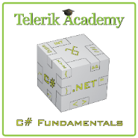



Free Trainings @ Telerik Academy
C# Programming @ Telerik Academy
csharpfundamentals.telerik.com
Telerik Software Academy
academy.telerik.com
Telerik Academy @ Facebook
facebook.com/TelerikAcademy
Telerik Software Academy Forums
forums.academy.telerik.com

